Slide 1
Goldwater Scholarship
Nationally Competitive Awards
Campus Deadline: October 15, 2018

Slide 2
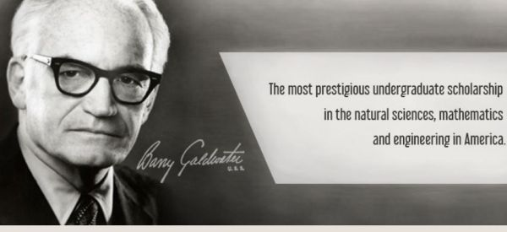
The Scholarship
Authorized by Congress in 1986 to provide the U.S. with a continuing source of highly qualified scientists, mathematicians, and engineers.
Named for Barry Goldwater, who served for 30 years in the US senate
Goldwater Scholarship

Slide 3
Eligibility
Sophomore (two years remaining beginning Fall 2019) or junior (one year remaining beginning Fall 2019)
Top quartile of class, with minimum 3.0 GPA (though “competitive” candidates are going to be > 3.8)
Be a United States citizen, national, or permanent resident
Have research experience, discipline-related employment or other significant involvement demonstrating intellectual curiosity and potential.
Goldwater Scholarship

Slide 4
The Scholarship
Appx. 250/year, awarded on the basis of merit
Candidates must demonstrate outstanding potential and intend to pursue research careers in mathematics, the natural sciences or engineering
It is assumed that students will complete an advanced degree; nearly all plan to complete a PhD. (Medical school aspirants are eligible only if they plan a career in research.)
Awards of up to $7,500 for use in the following year(s)
Applicants must have institutional endorsement (4/year)
Goldwater Scholarship
Notes:
Scholarship will contribute to “Total Cost of Attendance”
Do not hesitate to apply if you already receive scholarships… This award is about far more than the money (and any funds offset can be put to good use somewhere else)

Slide 5
Your Odds
ISU Campus Applicants
(4 selected by Committee)
1,286
National Applicants
240
Scholars
307
Honorable Mention
24%
19%
Goldwater Scholarship
Notes:
Honorable mention show promise and get the accolade…but no $$$
#s are from 2017 competition

Slide 6
The Odds
144 men, 108 women
30 Math
137 Science
59 Engineering
6 Computer Science
Juniors are statistically more likely to win than sophomore, not by preference, but because they usually have more research experience
Average GPA of winners is 3.95; grades in major and STEM-related fields are extremely important
Goldwater Scholarship
Notes:
2016 data

Slide 7
Nationally Competitive Awards
The odds are long…..BUT…..
There are some excellent candidates at ISU and we have processes in place to support you
You’ll never know unless you apply
Value the process….
Develop personal goals and statements
Build relationships with faculty
Being invited here and being selected at the university level is a large honor
Goldwater Scholarship
Notes:
Once you apply for Goldwater…you may consider…..Rhodes, Marshall, Knight-Hennessy, Gates-Cambridge, etc.
IF you plan on graduate school…you will know how to prepare an application and have thought through your goals.
IF a sophomore and not selected this year…you can apply for next year.

Slide 8
Application Process
ISU Campus DL: October 15, 2018
Application Work:
Nov-Jan, 2018
National DL: Jan 25, 2019
Goldwater Scholars Announced: Late March, 2019
Selection of 4 ISU Candidates by Oct 26, 2018
Goldwater Scholarship

Slide 9
Campus Application
Narratives: In combination, should convey your desire and potential to be a researcher
Research Descriptions: The environment (lab, field work, etc), the research question, what you did, what skills you’ve developed, any presentations, publications from it.
Essay: Written to be read by educated scientists. 3 pages max
1st Section: background and methodology
2nd Section: data collection and analysis, results, future directions
View a sample application HERE.
Apply HERE.
Goldwater Scholarship
Notes:
Career Goals Narrative = 3,000 characters
Defining Experience Narrative = 1,500 characters
Optional Diversity Narrative = 1,500 characters
Research Essay is 3 pages max

Slide 10
Prepare
Review the Goldwater Website
Review the candidate resources on the website for Nationally Competitive Awards
View a sample application HERE
Find a faculty mentor to review your research essay
Take your narrative essays to the Writing and Media Center
Apply HERE
Goldwater Scholarship
Notes:
Narratives are 300 words max
Essay is 3 pages max

Slide 11
Endorsed Candidate Application
Endorsed candidates work through application process
with Laura Good & Goldwater Committee
Final Application & Essays
References
Required documents
Completion and submission of materials
Some of this takes place over winter break….
Goldwater Scholarship
Notes:
Commitment…..

Slide 12
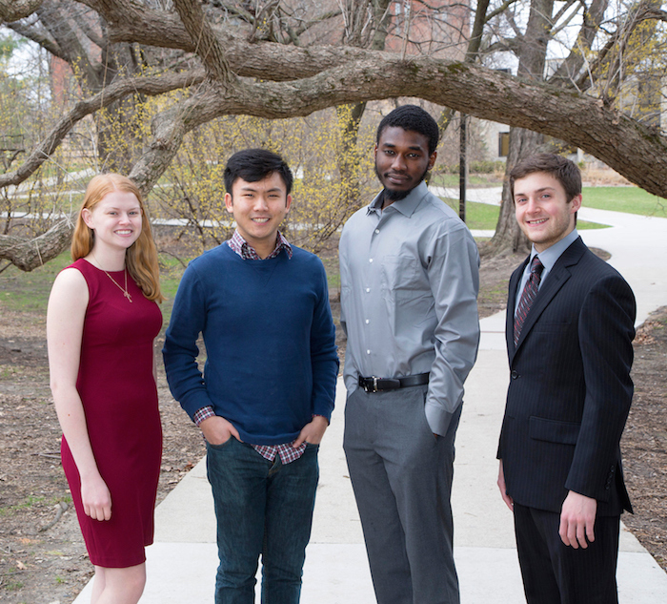
Who is a Goldwater Scholar?
Goldwater Scholarship

Slide 13
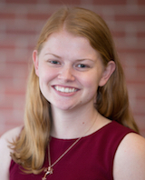
Who is a Goldwater Scholar?
Courtney Leigh Smith, a senior in genetics from Aurora, Illinois, will pursue a Ph.D. in neuroscience to research neurogenerative diseases on the cellular level in order to develop more effective treatment options. She currently studies the genetic basis of ALS (Lou Gehrig's disease), and is president of the Genetics Club and a peer mentor for the Genetics Learning Community. Last summer while researching at the Mayo Clinic, Smith defined the efficiency of genome editing techniques to be used in future clinical trials. She will conduct research at another Mayo Clinic this summer.
Goldwater Scholarship

Slide 14
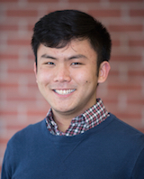
Who is a Goldwater Scholar?
Mengyu “Allen” Wang, a junior majoring in aerospace engineering, economics and mathematics from Bettendorf, plans on researching computational design at a university or government research center. Last summer, he interned at NASA’s Goddard Spaceflight Center, where he worked on measuring Newton’s Gravitational Constant from space with data from the LISA Pathfinder spacecraft. Most recently, his research focuses on optimization under uncertainty. This summer, he will work at NASA's Jet Propulsion Laboratory as a Caltech Summer Undergraduate Research Fellow.
Goldwater Scholarship

Slide 15
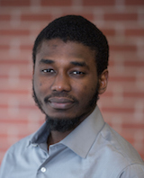
Who is a Goldwater Scholar?
Mouhamad Said Diallo, a junior majoring in mechanical engineering and materials engineering, from Ames, plans to earn a Ph.D. and pursue an academic career in sustainable energy and technology. Diallo moved from Dakar, Senegal, three years ago. He transferred to ISU from Des Moines Area Community College, where he co-authored a scholarly article in Physics Letters A while working with an ISU mechanical engineering researcher. Diallo participates in the Iowa Illinois Nebraska Stem Partnership for Innovation in Research and Education and the ISU McNair program, which prepares underrepresented students for graduate school.
Goldwater Scholarship

Slide 16
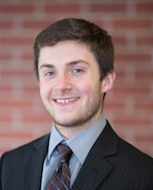
Who is a Goldwater Scholar?
Matthew David Cook, a senior in biochemistry and genetics from Coon Rapids, Minnesota, will pursue a Ph.D. to teach and research in the area of enzymology to improve protein engineering. Cook also conducted research in Valencia, Spain, as part of a study abroad program.
Goldwater Scholarship

Slide 17
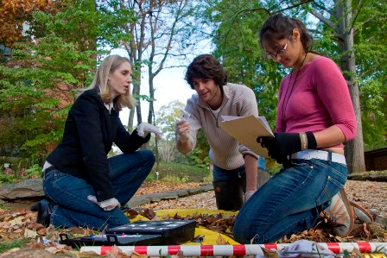
Undergraduate Research at ISU
For everyone who is interested in research
Campus-wide undergraduate research program
Dr. Svitlana Zbarska, program coordinator
szbar@iastate.edu, 294-2064, 2132 Jischke Honors Building
http://www.undergradresearch.iastate.edu/
Research Seminars for Undergraduate Students
U ST 275x Pre-research course How to apply for summer research internship
Annual Undergraduate Research Symposium
Research in the Capitol,
National Conference on Undergraduate Research
i-Research club
Undergraduate Research Ambassadors
Goldwater Scholarship

Slide 18
Questions? Laura Good Assistant Director Nationally Competitive Awards & University Honors Program lgood@iastate.edu 515-294-0172 *Schedule an individual appointment using Access Plus
Goldwater Scholarship

